Slide 1
Decision Trees & Bagging
Dongkuan (DK) Xu
NCSU Generative Intelligent Computing Lab
Computer Science, NC State University
04/26/2026

Slide 2


Generative Intelligent Computing (GIC) Lab

Slide 3
Decision Trees

Slide 4
Classification: Definition
Input: A collection of data objects (training dataset):
Each object includes a set of attributes.
One attribute is the class label, Y, and the rest are features, X.
Procedure: Find a model that maps the features to the class label: f: X → Y
Goal: Classify previously unseen data objects (test dataset) as accurately as possible.

Slide 5
Tid | Attrib1 | Attrib2 | Attrib3 | Class
1 | Yes | Large | 125K | No
2 | No | Medium | 100K | No
3 | No | Small | 70K | No
4 | Yes | Medium | 120K | No
5 | No | Large | 95K | Yes
6 | No | Medium | 60K | No
7 | Yes | Large | 220K | No
8 | No | Small | 85K | Yes
9 | No | Medium | 75K | No
10 | No | Small | 90K | Yes
10
Tid: The ID number of each record.
Attrib1: Whether a person has a certain property or status.
Attrib2: A size-level feature, with values such as Small, Medium, and Large.
Attrib3: Such as income or amount, measured in thousands.
Class: The target label we want to predict, with values Yes or No.
Tid | Attrib1 | Attrib2 | Attrib3 | Class
11 | No | Small | 55K | ?
12 | Yes | Medium | 80K | ?
13 | Yes | Large | 110K | ?
14 | No | Small | 95K | ?
15 | No | Large | 67K | ?
10

Slide 6
Tid | Attrib1 | Attrib2 | Attrib3 | Class
1 | Yes | Large | 125K | No
2 | No | Medium | 100K | No
3 | No | Small | 70K | No
4 | Yes | Medium | 120K | No
5 | No | Large | 95K | Yes
6 | No | Medium | 60K | No
7 | Yes | Large | 220K | No
8 | No | Small | 85K | Yes
9 | No | Medium | 75K | No
10 | No | Small | 90K | Yes
Tid | Attrib1 | Attrib2 | Attrib3 | Class
1 | Yes | Large | 125K | No
2 | No | Medium | 100K | No
3 | No | Small | 70K | No
4 | Yes | Medium | 120K | No
5 | No | Large | 95K | Yes
6 | No | Medium | 60K | No
7 | Yes | Large | 220K | No
8 | No | Small | 85K | Yes
9 | No | Medium | 75K | No
10 | No | Small | 90K | Yes
10
10
Training Set
Tid | Attrib1 | Attrib2 | Attrib3 | Class
11 | No | Small | 55K | ?
12 | Yes | Medium | 80K | ?
13 | Yes | Large | 110K | ?
14 | No | Small | 95K | ?
15 | No | Large | 67K | ?
Tid | Attrib1 | Attrib2 | Attrib3 | Class
11 | No | Small | 55K | ?
12 | Yes | Medium | 80K | ?
13 | Yes | Large | 110K | ?
14 | No | Small | 95K | ?
15 | No | Large | 67K | ?
10
10
Test Set

Slide 7
Illustrating Classification Task
Tid | Attrib1 | Attrib2 | Attrib3 | Class
1 | Yes | Large | 125K | No
2 | No | Medium | 100K | No
3 | No | Small | 70K | No
4 | Yes | Medium | 120K | No
5 | No | Large | 95K | Yes
6 | No | Medium | 60K | No
7 | Yes | Large | 220K | No
8 | No | Small | 85K | Yes
9 | No | Medium | 75K | No
10 | No | Small | 90K | Yes
Learning algorithm
Induction
Learn Model
Model
10
Training Set
Tid | Attrib1 | Attrib2 | Attrib3 | Class
11 | No | Small | 55K | ?
12 | Yes | Medium | 80K | ?
13 | Yes | Large | 110K | ?
14 | No | Small | 95K | ?
15 | No | Large | 67K | ?
Apply Model
Deduction
10
Test Set

Slide 8
Decision trees
One of the most intuitive classifiers.
Easy to understand and construct.
Surprisingly, also works very well.
Let’s build a decision tree!

Slide 9
How does a decision tree represent a prediction rule or model?
f: X → Y
Model: A mapping from all other attributes to the class label.

Slide 10
Decision Tree for Tax Fraud Detection
Test Data
Refund | Marital Status | Taxable Income | Cheat
No | Married | 80K | ?
Refund
Yes
No
NO
MarSt
Single, Divorced
Married
TaxInc
NO
< 80K
> 80K
NO
YES

Slide 11
Decision Tree for Tax Fraud Detection
Start from the root of tree.
Test Data
Refund | Marital Status | Taxable Income | Cheat
No | Married | 80K | ?
Refund
Yes
No
NO
MarSt
Single, Divorced
Married
TaxInc
NO
< 80K
> 80K
NO
YES

Slide 12
Decision Tree for Tax Fraud Detection
Test Data
Refund | Marital Status | Taxable Income | Cheat
No | Married | 80K | ?
Refund
Yes
No
NO
MarSt
Single, Divorced
Married
TaxInc
NO
< 80K
> 80K
NO
YES

Slide 13
Decision Tree for Tax Fraud Detection
Test Data
Refund | Marital Status | Taxable Income | Cheat
No | Married | 80K | ?
Refund
Yes
No
NO
MarSt
Single, Divorced
Married
TaxInc
NO
< 80K
> 80K
NO
YES

Slide 14
Decision Tree for Tax Fraud Detection
Test Data
Refund | Marital Status | Taxable Income | Cheat
No | Married | 80K | ?
Refund
Yes
No
NO
MarSt
Single, Divorced
Married
TaxInc
NO
< 80K
> 80K
NO
YES

Slide 15
Decision Tree for Tax Fraud Detection
Test Data
Refund | Marital Status | Taxable Income | Cheat
No | Married | 80K | ?
Refund
Yes
No
NO
MarSt
Single, Divorced
Married
TaxInc
NO
< 80K
> 80K
NO
YES

Slide 16
Decision Tree for Tax Fraud Detection
Test Data
Refund | Marital Status | Taxable Income | Cheat
No | Married | 80K | No
Refund
Yes
No
NO
MarSt
Single, Divorced
Married
Assign Cheat to “No”
TaxInc
NO
< 80K
> 80K
NO
YES

Slide 17
Decision Tree for Tax Fraud Detection
Test Data
Refund | Marital Status | Taxable Income | Cheat
No | Married | 80K | No
Refund
Yes
No
NO
MarSt
Single, Divorced
Married
Assign Cheat to “No”
TaxInc
NO
< 80K
> 80K
NO
YES

Slide 18
Structure of a decision tree
Internal nodes (yellow) sort instances based on an attribute.
Edges assign instances to a child node based on their attribute values.
Leaf nodes (blue) classify instances with a label.
Refund
Yes
No
NO
MarSt
Single, Divorced
Married
TaxInc
NO
< 80K
> 80K
NO
YES

Slide 19
Decision Tree Induction

Slide 20
Another Example of Decision Tree
Refund
MarSt
Single, Divorced
Yes
No
Married
NO
NO
MarSt
Refund
Married
Yes
No
Single, Divorced
NO
TaxInc
TaxInc
NO
< 80K
> 80K
< 80K
> 80K
NO
YES
NO
YES
There could be more than one tree that fits the same data!
Which one is better?

Slide 21
How do we know what the best decision tree is?

Slide 22
Selecting the Best Attribute

Slide 23
Building a decision tree
Function BuildTree(n,A) //n: samples (rows), A: attributes
If empty(A) or all n(L) are the same
status = leaf
class = most common class in n(L)
else
status = internal
a ⇐ bestAttribute(n,A)
LeftNode = BuildTree(n(a=1), A \ {a})
RightNode = BuildTree(n(a=0), A \ {a})
end
end
Refund
Yes
No
NO
MarSt
Single, Divorced
Married
TaxInc
NO
< 80K
> 80K
NO
YES

Slide 24
Measures of Best Attribute to Split
Misclassification error
Gini Index
Entropy & Information Gain

Slide 25
Assumption: Binary Split
Examples will assume that all attributes are binary:
Later we will discuss non-binary attributes.
Refund
Yes
No
NO
MarSt

Slide 26
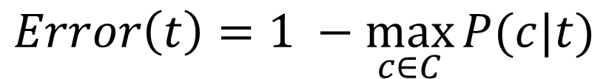
Misclassification Error
Misclassification error at a node t:
“If this was a leaf node, how poorly would it do?”
Maximum value is (1 - 1/n_{c})
E.g. 3 Yes, 3 No → 50% error
Minimum is 0
E.g. 4 Yes, 0 No → 0% Error
$$Error\left(t\right)=1 −\max_{c∈C}{P(c|t)}$$
Number of classes
Probability of having class c in note t.
Error = 1 - 3/5 = 2/5 = 0.4

Slide 27
Misclassification Error of a Split
Color
How many instances are misclassified?
Node R: 1 - 4/6 = 2/6 = 33%
Node B: 1 - 3/4 = 1/4 = 25%
Red
Blue
Node R
Node B
Class | Red | Blue
True | 4 | 1
False | 2 | 3
Total: | 6 | 4
Step 1: Calculate error for each child node

Slide 28
Misclassification Error of a Split
Color
How many instances are misclassified?
Node R: 1 - 4/6 = 2/6 = 33%
Node B: 1 - 3/4 = 1/4 = 25%
Weighted Average:
(6/10) * 33% + (4/10) * 25% =
30% ← Misclassification Error
Red
Blue
Node R
Node B
Class | Red | Blue
True | 4 | 1
False | 2 | 3
Total: | 6 | 4
Step 1: Calculate error for each child node

Slide 29
 | Parent
True | 5
False | 5
Color
Red
Blue
Node R
Node B
Split on Attribute “Color” or “Size”?
 | Red | Blue
True | 4 | 1
False | 2 | 3
Error: 30%
Size
Small
Large
Node S
Node L
 | Small | Large
True | 2 | 3
False | 5 | 0
Error: ??

Slide 30
Misclassification Error of a Split
Size
How many instances are misclassified?
Node S: 1 - 5/7 = 2/7 = 29%
Node L: 1 - 3/3 = 0/3 = 0%
Weighted Average:
(7/10) * 29% + (3/10) * 0% =
20% ← Misclassification Error
Small
Large
Node S
Node L
Class | Small | Large
True | 2 | 3
False | 5 | 0
Total: | 7 | 3

Slide 31
Color
Red
Blue
Node R
Node B
 | Red | Blue
True | 4 | 1
False | 2 | 3
Error: 30%
Split on “Size”: Lower error
Size
Small
Large
Node S
Node L
 | Small | Large
True | 2 | 3
False | 5 | 0
Error: 20%

Slide 32
Non-Binary Attributes
So far, examples have been binary (Yes/No) attributes…
What about other attributes?
Refund
Yes
No
NO
MarSt

Slide 33
Splitting Nominal Attributes
Car Type: {Family, Sports, Luxury}
Binary split: Divides values into two subsets. Try them all, find the best one.
CarType
CarType
{Sports, Luxury}
OR
{Family, Luxury}
{Family}
{Sports}
Multi-way split: Use as many partitions as distinct values.
CarType
Family
Sports
Luxury

Slide 34
Splitting Continuous Attributes
Taxable Income
> 80K?
Taxable Income?
< 10K
> 80K
Yes
No
[10K,25K)
[25K,50K)
[50K,80K)
(i) Binary split
(ii) Multi-way split

Slide 35
Ensemble Methods

Slide 36
Ensemble Methods
Construct a set of classifiers from the training data.
Predict class label of previous unseen records by aggregating predictions made by multiple classifiers.

Slide 37
Bagging

Slide 38





General Idea
Original Training data
D
....
Step 1: Create Multiple
Data Sets
D₁
D₂
^{D}t-1
D_{t}
Step 2: Build Multiple
Classifiers
C
C
C
C
1
2
t -1
t
Step 3: Combine Classifiers
_{C}*

Slide 39
Why does it work?
Suppose there are 25 base classifiers:
Each classifier has an error rate: ε=0.35.
Assume classifiers are independent.
Probability that the ensemble classifier makes the wrong prediction is: ??

Slide 40
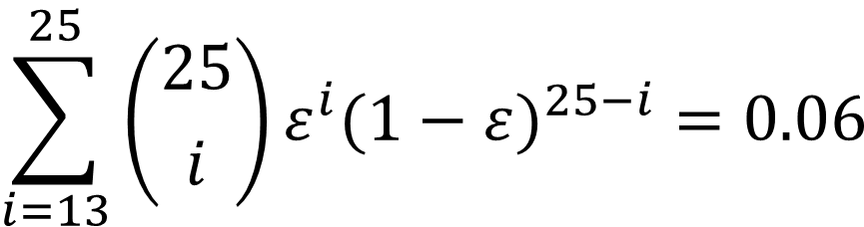
Why does it work?
Suppose there are 25 base classifiers:
Each classifier has an error rate: ε=0.35.
Assume classifiers are independent.
Probability that the ensemble classifier makes the wrong prediction is:
$$\sum_{i=13}^{25}{\left({25 \atop i}\right)ε^{i}({1−ε)}^{25−i}=0.06}$$

Slide 41
Examples of Ensemble Methods
How to generate an ensemble of classifiers?
Bagging
Boosting
Bayesian Model Averaging
Buckets
Stacking
…

Slide 42
Bagging
Sampling with replacement
Build classifier on each bootstrap sample
Each instance has probability (1 – 1/n)^{n} of NOT being selected
Original Data | 1 | 2 | 3 | 4 | 5 | 6 | 7 | 8 | 9 | 10
Bagging (Round 1) | 7 | 8 | 10 | 8 | 2 | 5 | 10 | 10 | 5 | 9
Bagging (Round 2) | 1 | 4 | 9 | 1 | 2 | 3 | 2 | 7 | 3 | 2
Bagging (Round 3) | 1 | 8 | 5 | 10 | 5 | 5 | 9 | 6 | 3 | 7

Slide 43

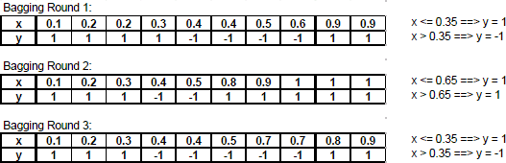
Bagging, continued
Original data (x) and labels (y):
Bootstrap Samples:
Weak classifier: Decision Sump (1-level binary decision tree).

Slide 44
Bagging, continued
Original data (x) and labels (y):
Bootstrap Samples:
Weak classifier: Decision Sump (1-level binary decision tree).

Slide 45
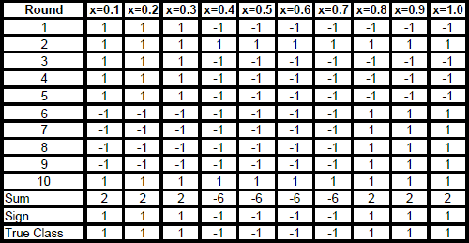
Bagging, results
Apply the classifier to the original training dataset (not the bootstrap sample).

Slide 46
Bagging, continued
Original data (x) and labels (y)
Bootstrap Samples

Slide 47
Bagging, continued
Original data (x) and labels (y)
Bootstrap Samples

Slide 48
Bagging, results

Slide 49
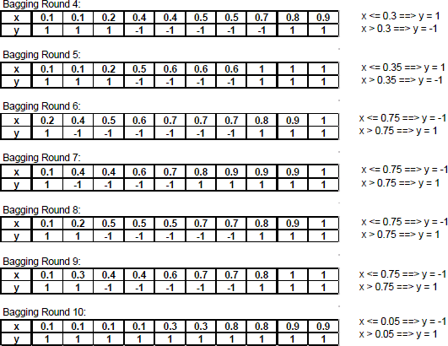
Bagging, continued

Slide 50
Bagging, results

Slide 51
Bagging, results

Slide 52
Bagging, results

Slide 53
Boosting

Slide 54
Boosting
More likely to sample instances that were misclassified in previous rounds.
Weight: The likelihood of an instance being sampled.
Initially, all records are assigned equal weights.
Unlike bagging, weights may change at the end of the boosting round.

Slide 55
Boosting
Key Insight: Sample intelligently, not randomly!
Records that are wrongly classified will have their weights increased, and vice versa.
Example 4 is hard to classify.
Its weight is increased → more likely to be sampled in subsequent rounds.
Original Data | 1 | 2 | 3 | 4 | 5 | 6 | 7 | 8 | 9 | 10
Boosting (Round 1) | 7 | 3 | 2 | 8 | 7 | 9 | 4 | 10 | 6 | 3
Boosting (Round 2) | 5 | 4 | 9 | 4 | 2 | 5 | 1 | 7 | 4 | 2
Boosting (Round 3) | 4 | 4 | 8 | 10 | 4 | 5 | 4 | 6 | 3 | 4

Slide 56
Boosting
ML
f₁
Training Sample
ML
f₂
Weighted Sample
f
…
ML _{f}
M
Weighted Sample

Slide 57
Thanks!
Dongkuan (DK) Xu
NCSU Generative Intelligent Computing Lab
Computer Science, NC State University
04/26/2026

